Slide 1
Code Quality
Part I Rohit Sardana

Slide 2
Agenda
Introduction
Scope
What to expect
Setting up the development environment
Setting up test application
Code walk through
Analyzing Result
What’s next

Slide 3
Introduction
Test Driven Development
Behavior Driven Development
Code Quality
Pair programming
Peer review
Static Analysis Tool e.g. FxCop
Code Analysis Tool e.g. StyleCop

Slide 4
Scope
Test Driver Development
Tools
Unit Testing tools http://www.c-sharpcorner.com/UploadFile/Santhi.M/comparison-of-unit-testing-tools-in-net/
Nunit : Open Source, Selective running of test cases, Integration with 3rd party tools (any script i.e rake/fake etc., Jenkins, TeamCity), Reliable, Reports generation, lots of documentation
MSTest : Integrated with Visual Studio, no rich reporting, Automatically links bugs in TFS
Xunit : Similar to Nunit, Integrated tightly with MSBuild, lack of documentation
Mocking tool
Rhino, Moq, NSubstitute
Code Coverage tool
Ncover, PartCover, dotCover, OpenCover
Report Generator tool
ReportGenerator

Slide 5
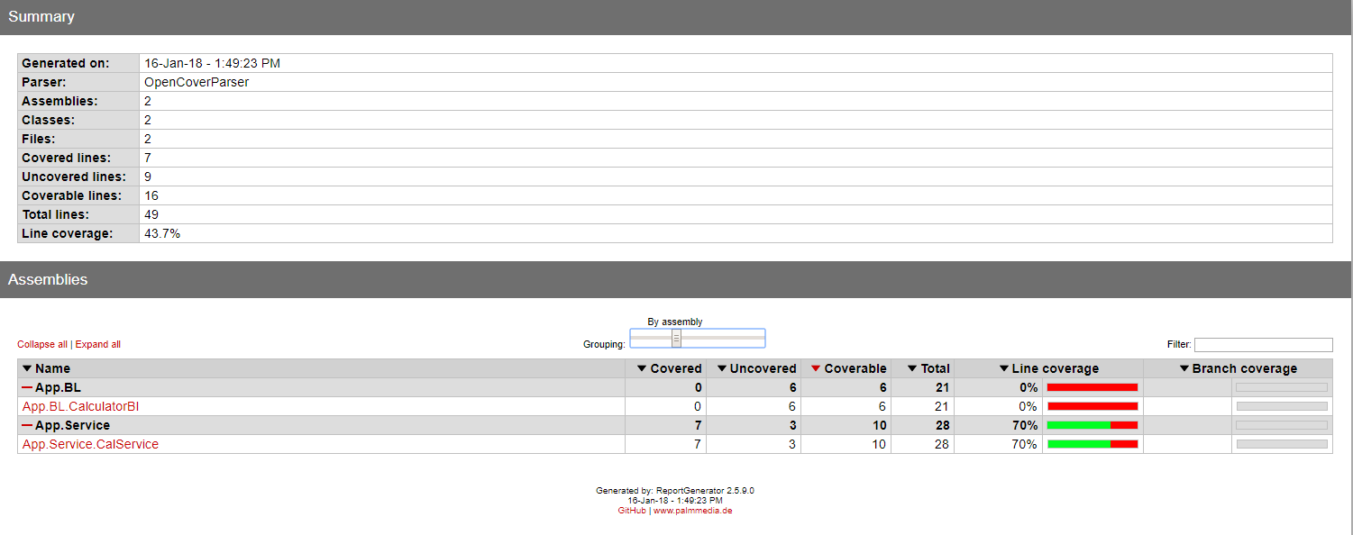
What to expect

Slide 6
Setting up Environment
Install .NET Core SDK 1.0.3
Browse the directory
Check C:\Prorgram Files\dotnet\shared\Microsoft.NETCore.App for installed Runtimes
Check C:\Prorgram Files\dotnet\sdk for installed SDKs
Command Line tool
dotnet - -version
dotnet - -info
dotnet runtime 1.1.1. is compatible with sdk 1.0.3

Slide 7
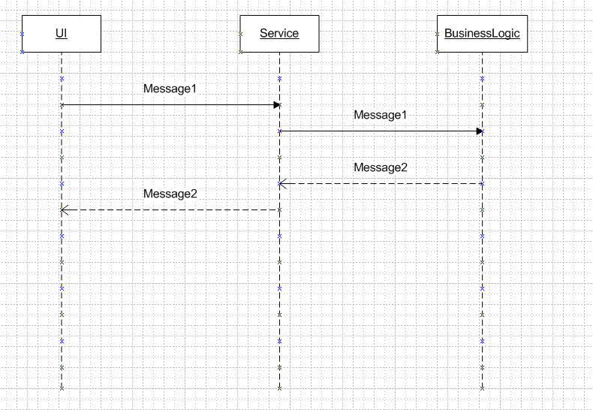
Setting up test project

Slide 8
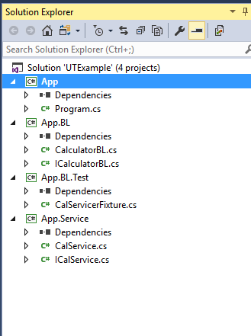
Setting the test project
Visual Studio -> .NET Core -> Console App
App.BL.Test project should install
Nunit 3.7.1
NUnitConsoleRunner 3.6.1
NUnit3TestAdapter 3.8.0
Moq 4.7.63
OpenCover 4.6.519
ReportGenerator 2.5.9.0
NUnit3TestAdapter allows the built-in Visual studio unit test runner to pick up and run NUnit3 tests.
NUnitConsoleRunner is a text base runner to run tests. It doesn’t show graphical indicator (green/red) It automatically saves its result in XML format, allowing you to produce reports or otherwise process results.
Moq Mocking library
OpenCover is a code coverage tool
ReportGenerator converts xml reports generated by Coverage tool into human readable reports in various formats.

Slide 9
Code walkthrough
Code walkthrough

Slide 10
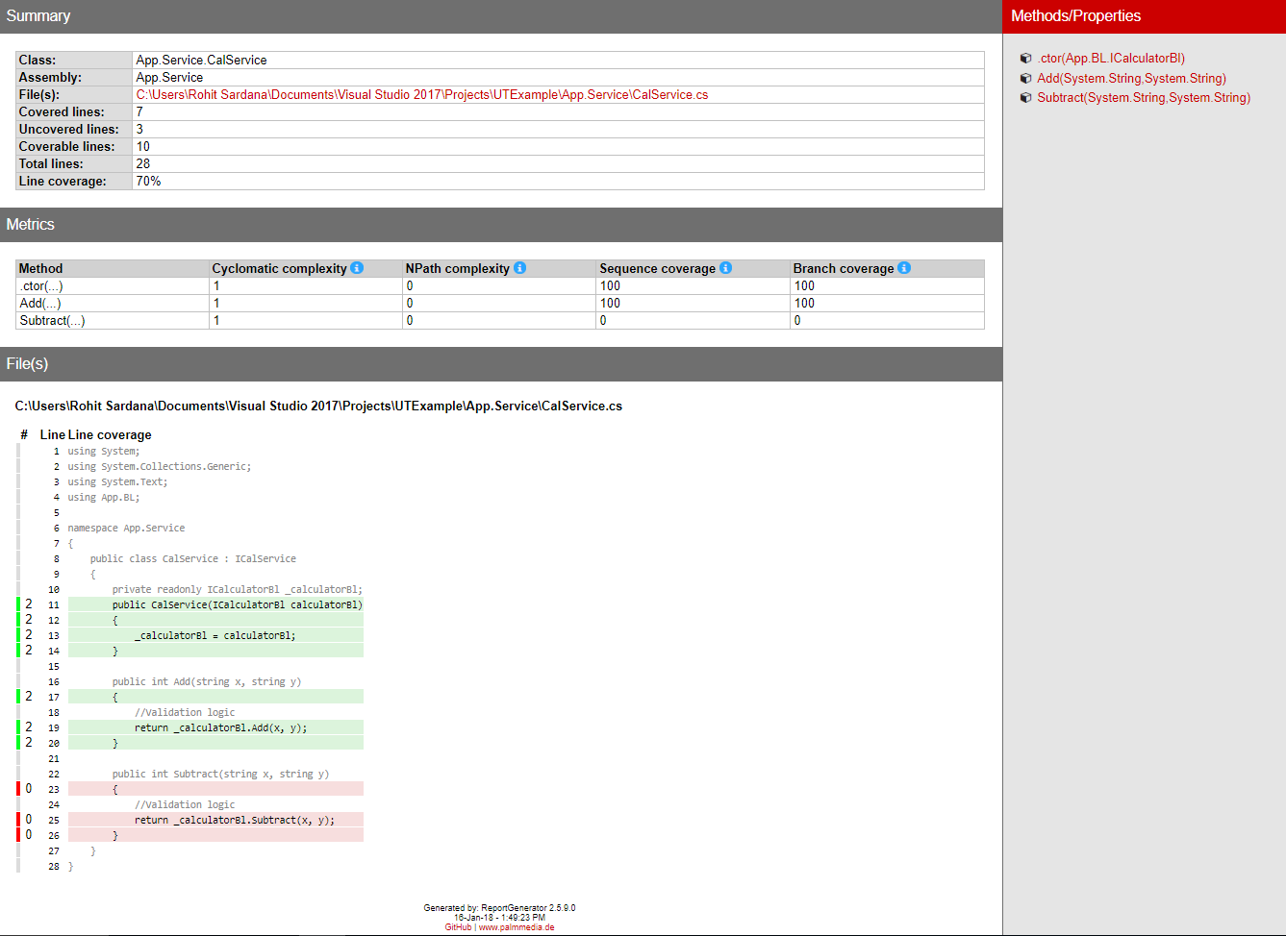
Analyzing Result
Cyclomatic complexity
Code
NPath complexity
Code
NPath complexity of 16 means that if you need 100% code coverage you need to test for 16 possible outcomes.
Statement Coverage: what lines have been covered.
Method Coverage: what methods have been covered.
Branch Coverage: which branches were taken. This is related to cyclometric complexity
Sequence Coverage: lines covered represented in terms of sequence. One sequence point can span several lines of code.
Visit OpenCover or ReportGenerator documentation for more details.

Slide 11
What’s Next
Dependency Injection tools such as StructureMap, Unity
Behavior Driven Development
Integrating it with Continuous Integration Server/Build server
….

Slide 12
Thank You

